Slide 1
Fill in Application Management Team Member Form
HA CRER Portal - Quick User Guide

Slide 2
What is Application Management Team Member Form for?
To assign the roles to your research team member to handle administrative work for Research Ethics Review Application through the Portal.
What is the Application Management Team comprised of?
Principal Investigator (PI)
Delegate [optional]
Follow-up User [optional]
Note: Delegate and Follow-up User can be the same person
The user permissions of the three roles are summarized as below:
Role | Handle Initial Application | Handle Post-approval Activities | Create Application Management Team | Update Application Management Team | Change of PI
PI | ✓ | ✓ | ✓ | Able to change the Delegates / Follow-up users | Upon CREC's approval, user could seek CREC Secretary's assistance to change the PI on the Portal.
Delegate | ✓ |  | ✓ | 
Follow-up User |  | ✓ | ✓ | 
HA CRER Portal - Quick User Guide

Slide 3
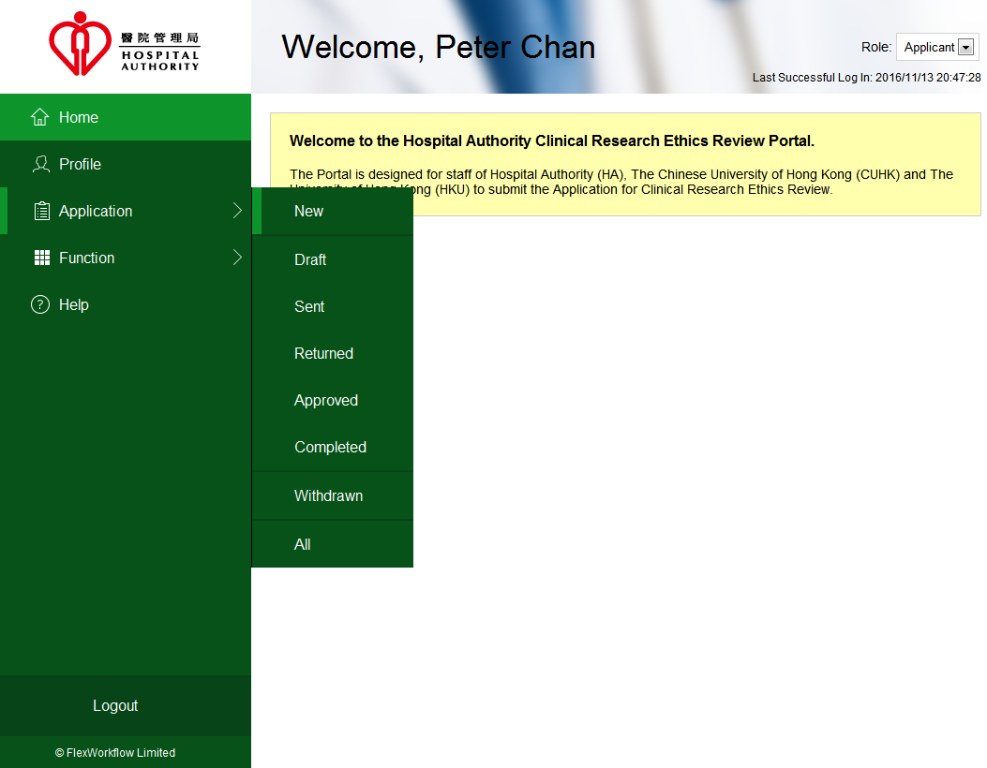
Navigate to [Application] -> [New] to start a new application.
An Application Management Team Member Form will be shown.
HA CRER Portal - Quick User Guide

Slide 4
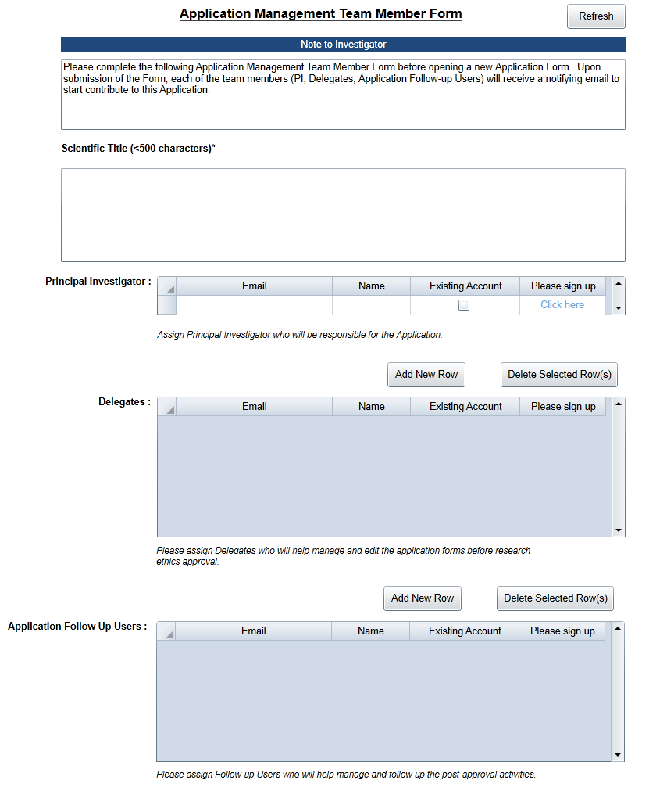
The form allows you to assign roles to your research team to handle the Pre-approval and Post-approval Activities
Mandatory field
Mandatory field
HA CRER Portal - Quick User Guide

Slide 5
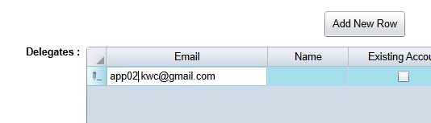
Click “Add New Row” to fill-in email address to assign Delegate / Follow-up User (if any) for the application.
HA CRER Portal - Quick User Guide

Slide 6
The Portal will auto-detected whether the email address you have entered is existing account or not.
HA CRER Portal - Quick User Guide

Slide 7
If the email address you have entered is NOT an existing account, which mean that your teammate does not have an account on the Portal yet.
Please click “Click here” to redirect to the Sign Up page to create an account for your teammate.
HA CRER Portal - Quick User Guide

Slide 8
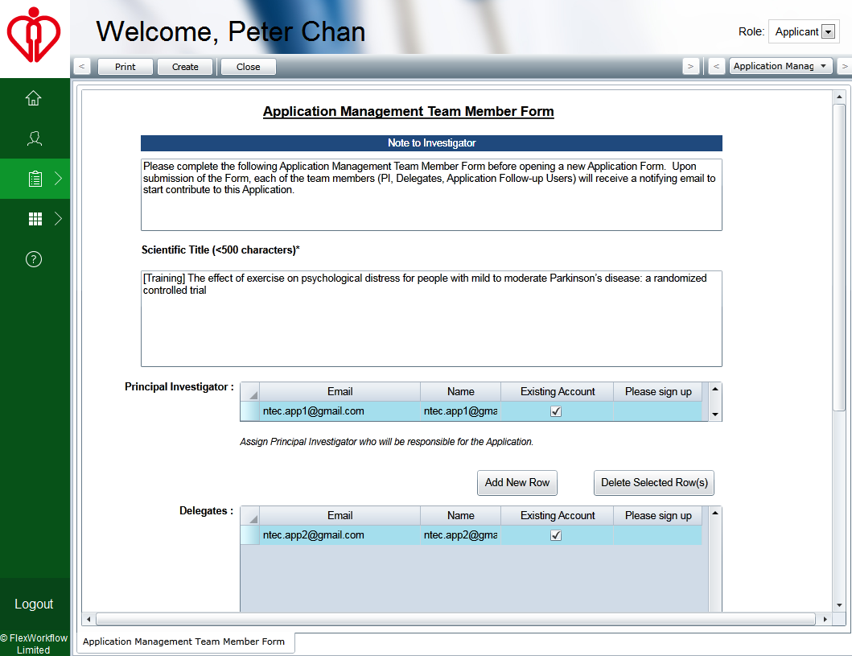
Make sure ALL your teammates has existing account.
When finished the Team Member Form, please click “Create” to create a new application.
HA CRER Portal - Quick User Guide

Slide 9
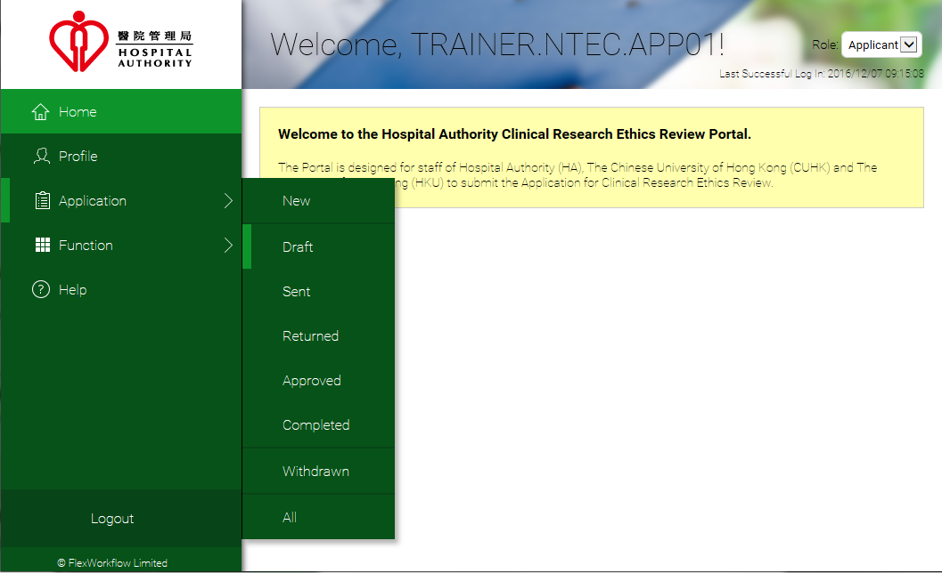
After Application Management Team Member Form submitted, your new application form is created under “Draft”.
(Navigate to [Application] -> [Draft])
HA CRER Portal - Quick User Guide

