Slide 1
Cross-cluster Study
(“Clone to draft” function)
HA CRER Portal - Quick User Guide

Slide 2
Note to Users:
For Cross-cluster Study – application needs to be submitted to respective Cluster RECs for research ethics review.
User could use “Clone to Draft” function to copy a submitted application with the same information to a new draft application for PI / Team member to submit the application to other Cluster RECs Office. After cloned an application, User need to modify the PI in the Application Management Team Member Form in order to transfer the new draft application to the PI’s account.
HA CRER Portal - Quick User Guide

Slide 3
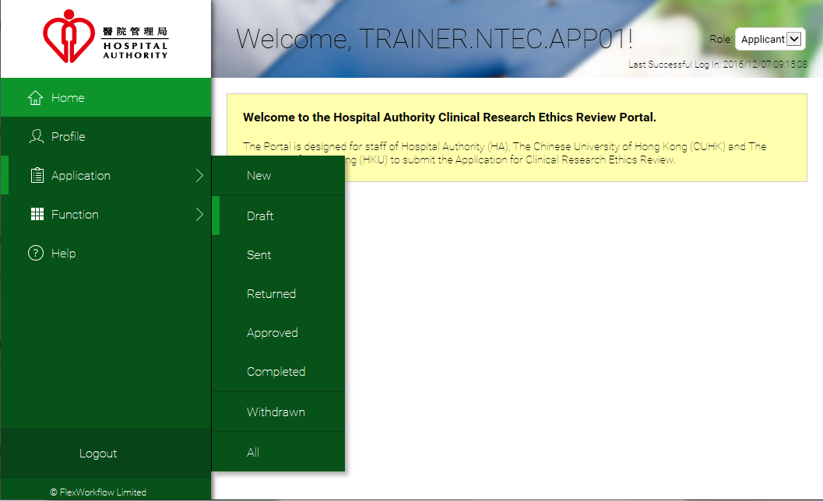
Select and open the submitted application that needs to be submitted in respective Cluster RECs Office for research ethics review.
[Application] > [Sent]
HA CRER Portal - Quick User Guide

Slide 4
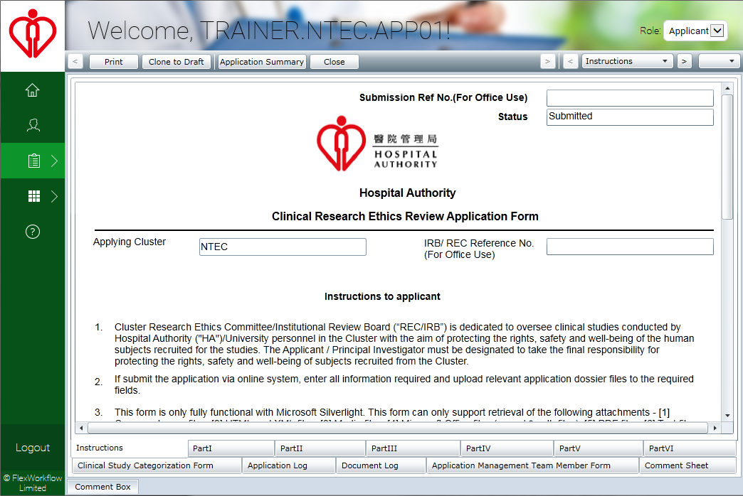
Click “Clone to Draft” on the tool bar to copy the application.
HA CRER Portal - Quick User Guide

Slide 5
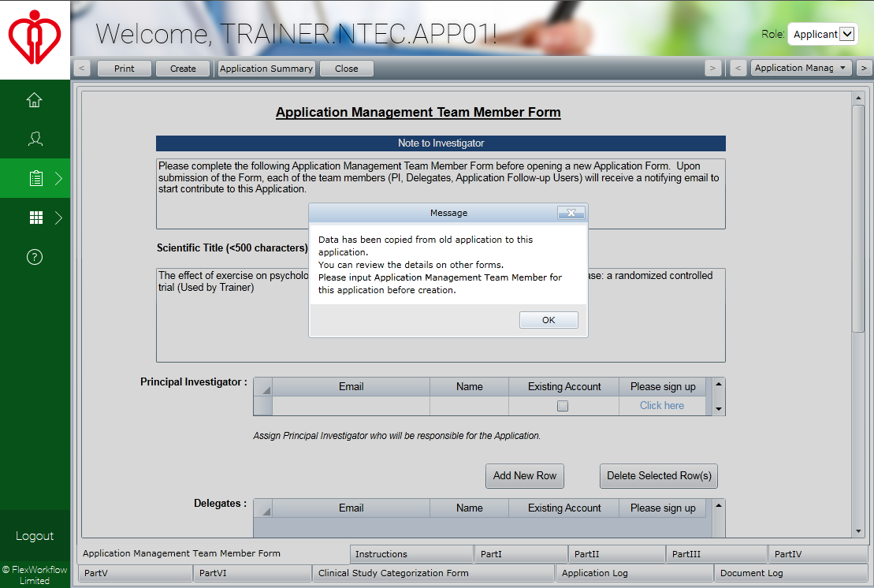
User will be re-directed to the Application Management Team Member Form, click “OK” to proceed and fill in the Application Management Team Member Form for the new application.
Remarks: Please note that the cloned application will only be sent to those PI and Delegate who was assigned on the Application Management Team Member Form.
HA CRER Portal - Quick User Guide

Slide 6
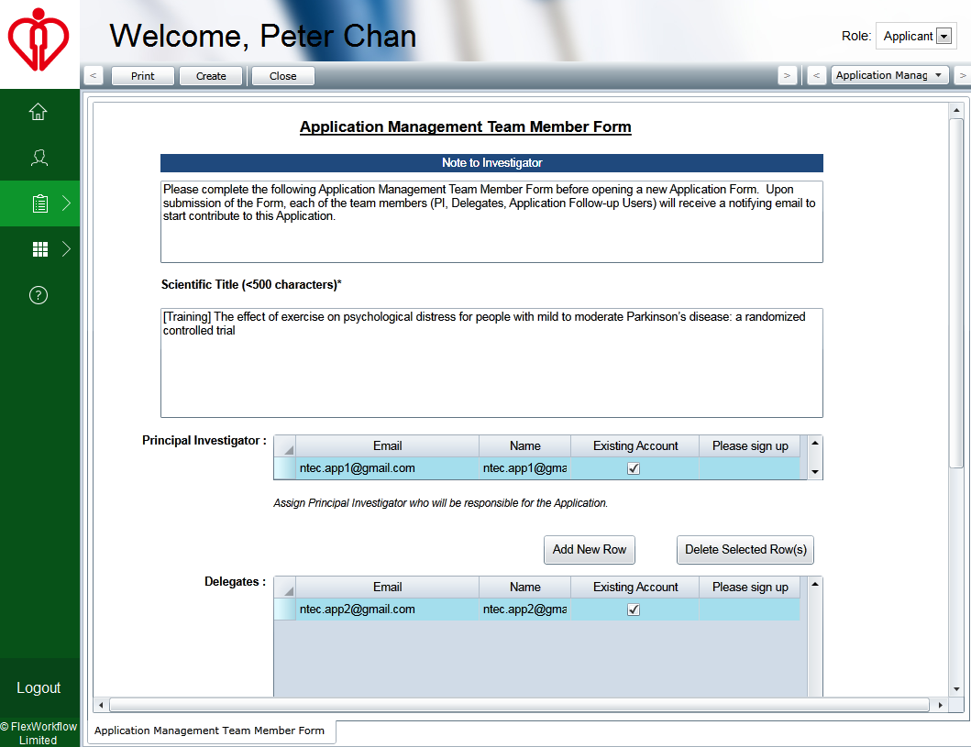
After completed the Team Member Form, click “Create” button on the tool bar
HA CRER Portal - Quick User Guide

Slide 7
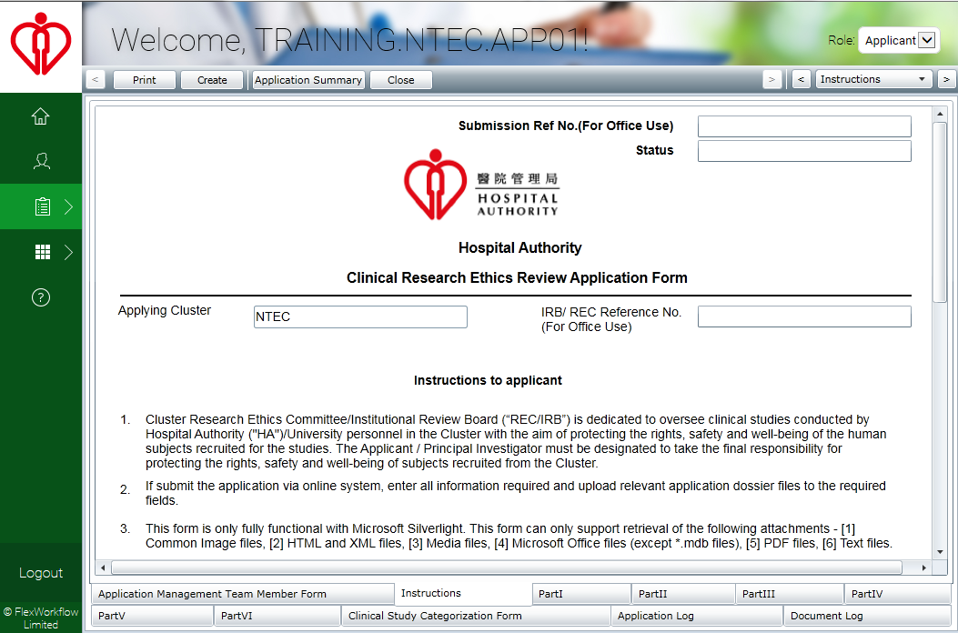
User will be redirected to the “Instruction” page, and click “Create” to proceed to next step.
HA CRER Portal - Quick User Guide

Slide 8
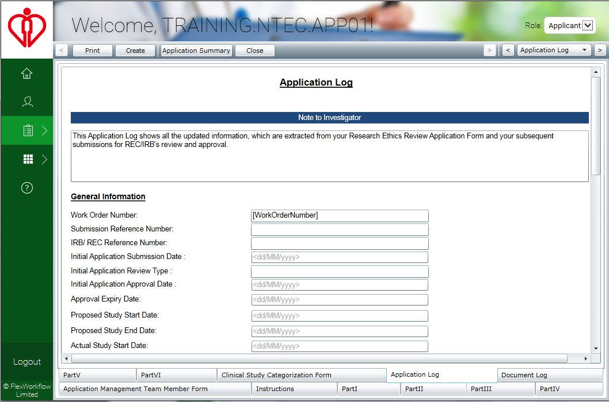
User will be redirected to the “Application Log” and the information in the Application Log will be cleared. Then, click “Create” to clone the application to “Draft”.
HA CRER Portal - Quick User Guide

Slide 9
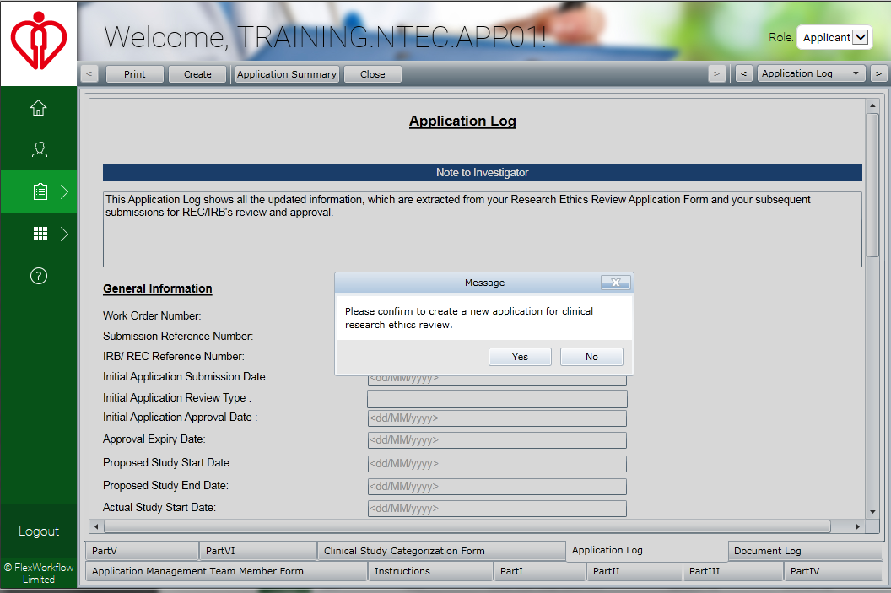
Click “Yes” to confirm to create a new draft application.
HA CRER Portal - Quick User Guide

Slide 10
The cloned draft application can be found under [Application] > [Draft].
HA CRER Portal - Quick User Guide

Slide 11
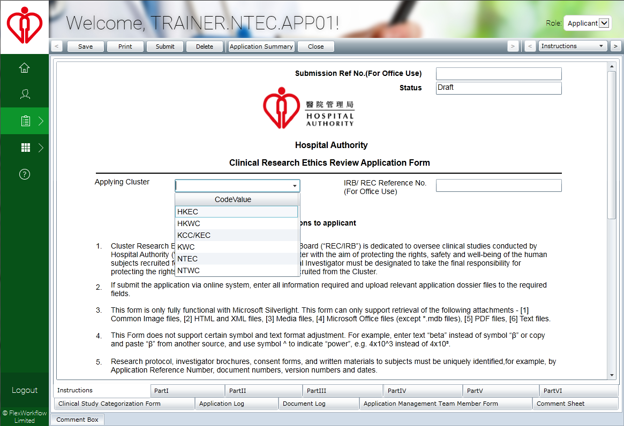
Applicant can now to choose a new “Applying Cluster” for Cross-cluster study application submission .
HA CRER Portal - Quick User Guide

