Slide 1
Handwritten Signature by PI or Department Head
(“Print” Function)
HA CRER Portal - Quick User Guide

Slide 2
Note to Users:
Portal does not require electronic signature, instead a hardcopy of the application document with handwritten signature are required to submit to Cluster RECs Office, such as Application Form, Progress Report, SAE Report, SUSAR Report etc. Please check with respective Secretariat for the requirements.
User could use the “Print” function:
1. To print a hardcopy of the application form / reports directly with filled-in information for PI and/or supervisors’ handwritten signature, while Users submit application / reports through the Portal
2. To save an application form (Instruction page, Part I – Part VI) with filled-in information in PDF format and print out a hard copy.
HA CRER Portal - Quick User Guide

Slide 3
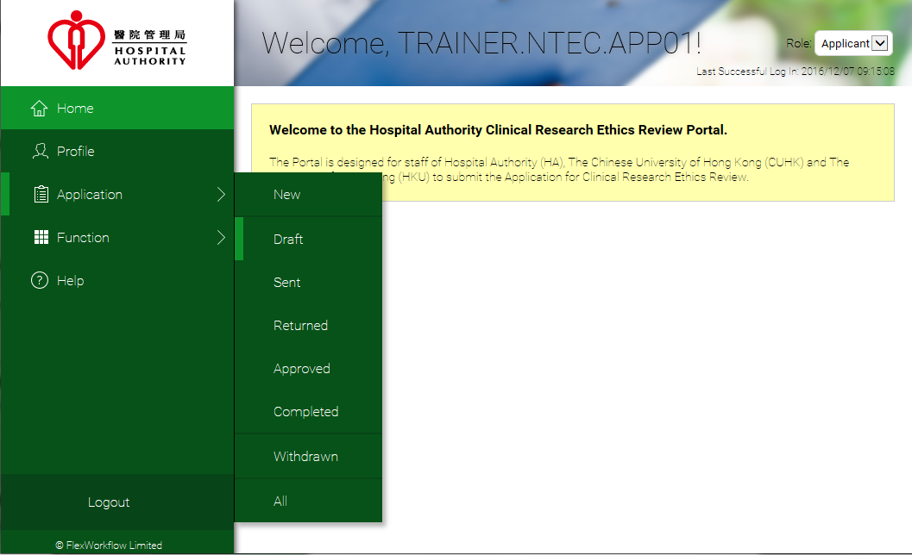
(Navigate to [Application] -> [Draft])
HA CRER Portal - Quick User Guide

Slide 4
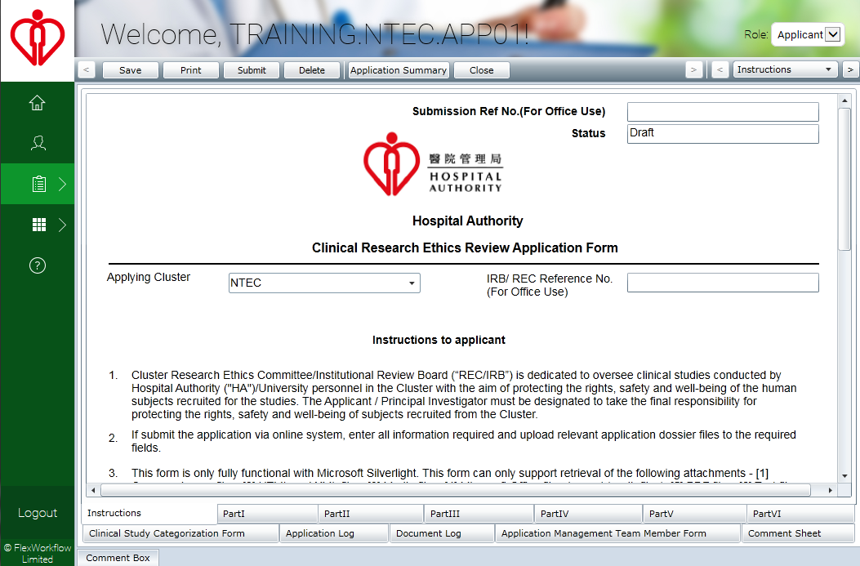
“Print” button is available at the toolbar on top of the application form
HA CRER Portal - Quick User Guide

Slide 5
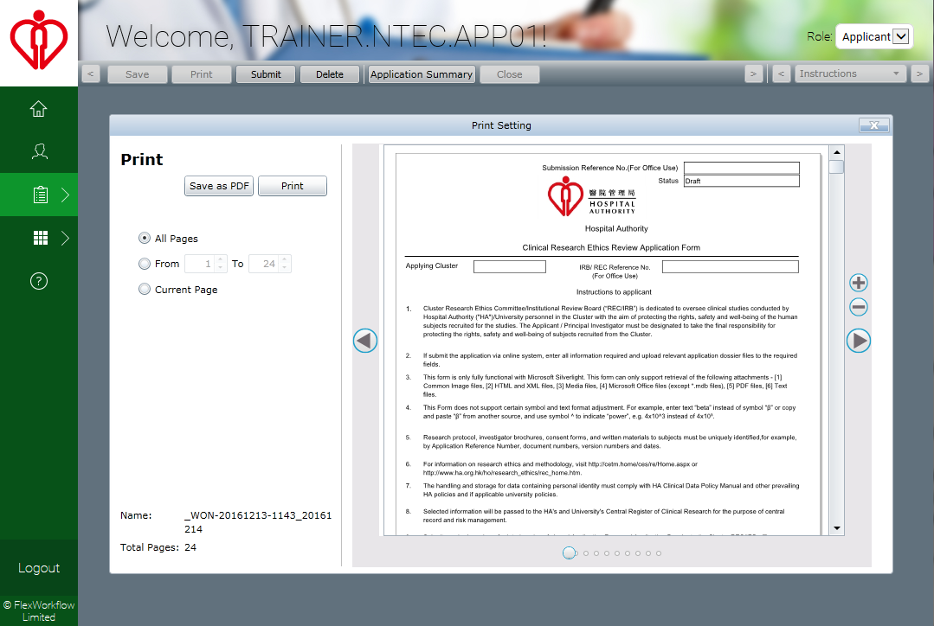
Two options to choose:
Save as PDF: save the application form as a PDF file
Print: All pages, the current page or specified page range
HA CRER Portal - Quick User Guide

